Slide 1


Jed Wible
2021-12-13

Slide 2

Outline
Executive Summary
Introduction
Methodology
Results
Conclusion
Appendix

Slide 3

Executive Summary
Summary of methodologies
Data Collection Via Application Interface (API)
Data Wrangling
Exploring Data with SQL
Visual Data Analysis
Predictive Analysis
Summary of all results
Visualized results
Conclusion

Slide 4
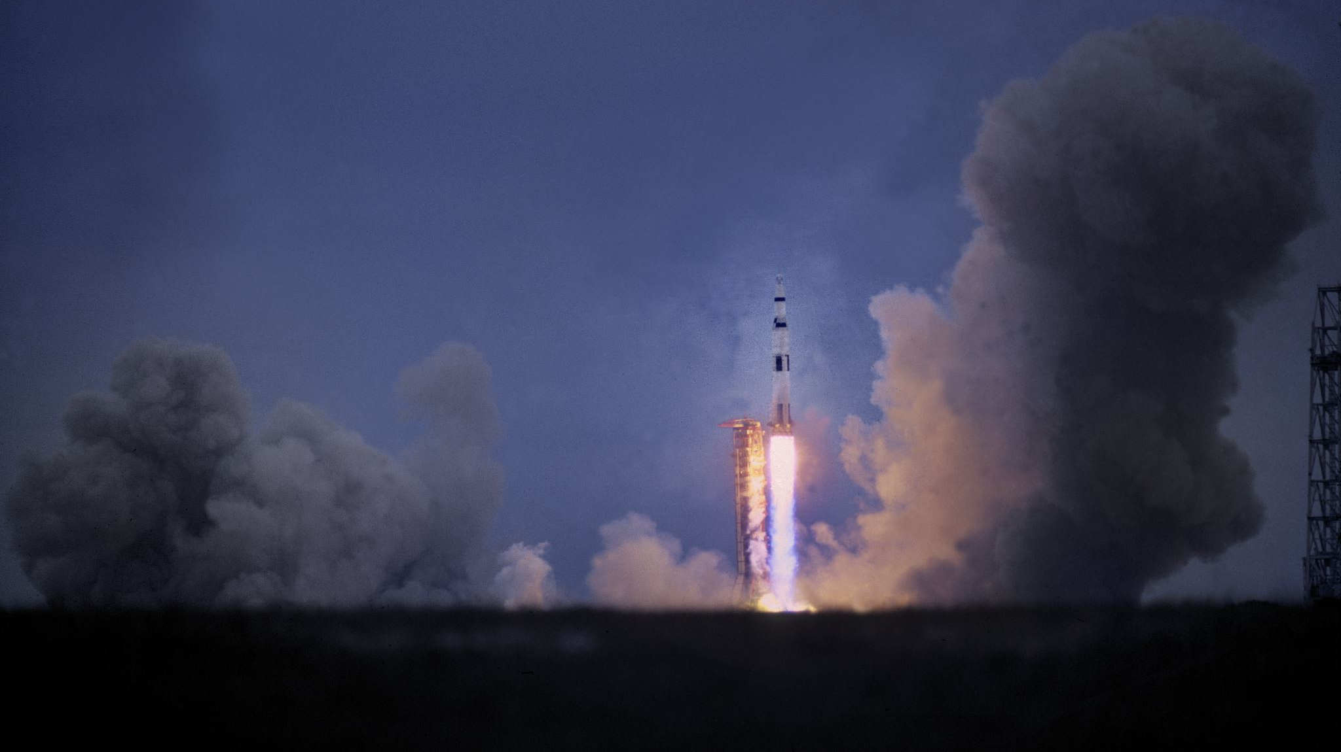

Introduction
SpaceX has changed the space industry with their reusable core launch stages
How likely are their reusable stages to land safely after launch?

Slide 5
A note to peer reviewers:
I prefer presentations to have minimal graphics, fewer lines of text, and less in-depth explanations. My goal is to present the meaningful information as simply as possible so the viewer can quickly understand the information.
Minimalism overview:
https://www.instructionaldesign.org/theories/minimalism/

Slide 6

Methodology
Executive Summary
Data collection methodology:
Data wrangling and cleaning
Exploratory data analysis (EDA) using visualization and SQL database tools
Interactive visual analytics using Python libraries Folium and Plotly Dash
Predictive analysis using classification models
Summary of findings

Slide 7
methodology

Slide 8
Methodology
Data collection Methodology High Level Summary:
Connect directly to a data source using a REST API connection
Webscraping Wikepedia to process the HTML tables containing launch information and convert it into a usable data source.

Slide 9
Data Collection – SpaceX API
Normalize
Create Frame
Data Pull Via API
df=pd.DataFrame.from_dict(launch_dict)
data=pd.json_normalize(response.json())
response=requests.get(spacex_url)
Filter
data_falcon9=df[df['BoosterVersion']!='Falcon 1']
Source data was collected from a website tracking SpaceX launch data.
Data is normalized, filtered, and cleaned providing a starting point for analysis.
API Spec: https://api.spacexdata.com/v4/rockets/
Notebook Link: https://github.com/jedwible/AppliedDataScienceCapstone/blob/main/Data%20Collection%20API.ipynb/

Slide 10
Data Collection – Web Scraping
Using the beautifulsoup4 library we converted the raw HTML tables from the site into usable data per the workflow to the right.
Once the data is in a data frame, we save the contents as a CSV file for use in the remaining steps.
HTML page used as data source -- https://en.wikipedia.org/w/index.php?title=List_of_Falcon_9_and_Falcon_Heavy_launches&oldid=1027686922/
Pull From URL
data=requests.get(static_url).text
Convert Using Soup
soup=BeautifulSoup(data,"html.parser")
Convert to Data Frame and Save
launch_dict=dict.fromkeys(column_names)
df.to_csv('spacex_web_scraped.csv',index=False)
html_tables=soup.find_all('table')
first_launch_table=html_tables[2]
name=extract_column_from_header(row)
fortable_number,tableinenumerate(soup.find_all('table',"wikitable plainrowheaders collapsible")):….
extracted_row+= launch_dict['Flight No.'].append(flight_number)#print(flight_number)datatimelist=date_time(row[0])…

Slide 11
Methodology
Data Wrangling
Data Wrangling is the pre-processing of raw data to evaluate its meaningfulness convert values as needed, find some patterns in the data and determine what would be the label for training supervised models.

Slide 12
Initial Data Wrangling
Exploratory Data Analysis Flow Chart
With the data file loaded into a Data Frame steps as outlined to the right were preformed using Python scripts.
Key tasks performed were assessing the landing types, determining how many were failed / non landings, and creating the attribute to track land / non landing in the dataset.
Count Null Data Values
ID Data Types
Count Launch Sites
Count Orbits
Count Landing Types
Assign Numeric values to orbit types
Create Landing Class Attribute
Link to Notebook with Python Code

Slide 13
Methodology
Exploratory Data Analysis (EDA) with SQL
EDA lets us look at the data at a high level and glean the important elements in preparation for modeling
Analysis was performed using IBM’s DB2 cloud platform using the SpaceXTBL table with data provided by the exercise.
SpaceXTBL Design
POSITION | column_name | data_type | length
0 | DATE | DATE | 4
1 | TIME__UTC_ | TIME | 3
2 | BOOSTER_VERSION | VARCHAR | 14
3 | LAUNCH_SITE | VARCHAR | 12
4 | PAYLOAD | VARCHAR | 61
5 | PAYLOAD_MASS__KG_ | INTEGER | 4
6 | ORBIT | VARCHAR | 11
7 | CUSTOMER | VARCHAR | 57
8 | MISSION_OUTCOME | VARCHAR | 32
9 | LANDING__OUTCOME | VARCHAR | 22
Link To EDA With SQL Jupyter Notebook

Slide 14
Methodology
Exploratory Data Analysis (EDA) with SQL
Data and SQL Statements used to obtain results
All launch sites
Booster Versions used for payloads between 4000 and 6000kg
2015 Launches without successful landings
launch_site
CCAFS LC-40
CCAFS SLC-40
KSC LC-39A
VAFB SLC-4E
booster_version
F9 FT B1021.2
F9 FT B1031.2
F9 FT B1022
F9 FT B1026
%sql Select DISTINCT launch_site from SPACEXTBL
SELECT DISTINCT(BOOSTER_VERSION)
FROM SPACEXTBL
WHERE LANDING__OUTCOME = 'Success (drone ship)'
AND PAYLOAD_MASS__KG_ > 4000
AND PAYLOAD_MASS__KG_ < 6000;
SELECT LANDING__OUTCOME, BOOSTER_VERSION, LAUNCH_SITE
FROM SPACEXTBL
WHERE LANDING__OUTCOME != 'Success%'
AND YEAR(DATE) = 2015
landing__outcome | booster_version | launch_site
Failure (drone ship) | F9 v1.1 B1012 | CCAFS LC-40
Controlled (ocean) | F9 v1.1 B1013 | CCAFS LC-40
No attempt | F9 v1.1 B1014 | CCAFS LC-40
Failure (drone ship) | F9 v1.1 B1015 | CCAFS LC-40
No attempt | F9 v1.1 B1016 | CCAFS LC-40
Precluded (drone ship) | F9 v1.1 B1018 | CCAFS LC-40
Success (ground pad) | F9 FT B1019 | CCAFS LC-40
Link To EDA With SQL Jupyter Notebook

Slide 15
Methodology
Exploratory Data Analysis (EDA) with SQL
Data and SQL Statements used to obtain results
The information to the right shows us an important piece of information we must consider when predicting the landing success. There were 10 launches where no landing was attempted. This is an expected result and not considered an unsuccessful landing attempt.
Counts of all landing types over select time period
SELECT COUNT(LANDING__OUTCOME), LANDING__OUTCOME FROM SPACEXTBL
WHERE DATE > '2010-06-04'
AND DATE < '2017-03-20'
GROUP BY LANDING__OUTCOME
Count | landing__outcome
3 | Controlled (ocean)
5 | Failure (drone ship)
1 | Failure (parachute)
10 | No attempt
1 | Precluded (drone ship)
5 | Success (drone ship)
3 | Success (ground pad)
2 | Uncontrolled (ocean)
Link To EDA With SQL Jupyter Notebook

Slide 16
Methodology
Perform interactive visual analytics using Folium and Plotly Dash
Graph, chart, and map data in an easy to comprehend format.

Slide 17
Methodology
Perform predictive analysis using classification models
How to build, tune, evaluate classification models
What can we predict about future booster landings?

Slide 18
EDA with Data Visualization
Summarize what charts were plotted and why you used those charts
Add the GitHub URL of your completed EDA with data visualization notebook, as an external reference and peer-review purpose

Slide 19
EDA with SQL
Using bullet point format, summarize the SQL queries you performed
Add the GitHub URL of your completed EDA with SQL notebook, as an external reference and peer-review purpose

Slide 20
Build an Interactive Map with Folium
Summarize what map objects such as markers, circles, lines, etc. you created and added to a folium map
Explain why you added those objects
Add the GitHub URL of your completed interactive map with Folium map, as an external reference and peer-review purpose

Slide 21
Build a Dashboard with Plotly Dash
Summarize what plots/graphs and interactions you have added to a dashboard
Explain why you added those plots and interactions
Add the GitHub URL of your completed Plotly Dash lab, as an external reference and peer-review purpose

Slide 22
Predictive Analysis (Classification)
Summarize how you built, evaluated, improved, and found the best performing classification model
You need present your model development process using key phrases and flowchart
Add the GitHub URL of your completed predictive analysis lab, as an external reference and peer-review purpose

Slide 23
Results
Exploratory data analysis results
Interactive analytics demo in screenshots
Predictive analysis results

Slide 24


Slide 25
Flight Number vs. Launch Site
Show a scatter plot of Flight Number vs. Launch Site
Show the screenshot of the scatter plot with explanations

Slide 26
Payload vs. Launch Site
Show a scatter plot of Payload vs. Launch Site
Show the screenshot of the scatter plot with explanations

Slide 27
Success Rate vs. Orbit Type
Show a bar chart for the success rate of each orbit type
Show the screenshot of the scatter plot with explanations

Slide 28
Flight Number vs. Orbit Type
Show a scatter point of Flight number vs. Orbit type
Show the screenshot of the scatter plot with explanations

Slide 29
Payload vs. Orbit Type
Show a scatter point of payload vs. orbit type
Show the screenshot of the scatter plot with explanations

Slide 30
Launch Success Yearly Trend
Show a line chart of yearly average success rate
Show the screenshot of the scatter plot with explanations

Slide 31
All Launch Site Names
Find the names of the unique launch sites
Present your query result with a short explanation here

Slide 32
Launch Site Names Begin with 'CCA'
Find 5 records where launch sites begin with `CCA`
Present your query result with a short explanation here

Slide 33
Total Payload Mass
Calculate the total payload carried by boosters from NASA
Present your query result with a short explanation here

Slide 34
Average Payload Mass by F9 v1.1
Calculate the average payload mass carried by booster version F9 v1.1
Present your query result with a short explanation here

Slide 35
First Successful Ground Landing Date
Find the dates of the first successful landing outcome on ground pad
Present your query result with a short explanation here

Slide 36
Successful Drone Ship Landing with Payload between 4000 and 6000
List the names of boosters which have successfully landed on drone ship and had payload mass greater than 4000 but less than 6000
Present your query result with a short explanation here

Slide 37
Total Number of Successful and Failure Mission Outcomes
Calculate the total number of successful and failure mission outcomes
Present your query result with a short explanation here

Slide 38
Boosters Carried Maximum Payload
List the names of the booster which have carried the maximum payload mass
Present your query result with a short explanation here

Slide 39
2015 Launch Records
List the failed landing_outcomes in drone ship, their booster versions, and launch site names for in year 2015
Present your query result with a short explanation here

Slide 40
Rank Landing Outcomes Between 2010-06-04 and 2017-03-20
Rank the count of landing outcomes (such as Failure (drone ship) or Success (ground pad)) between the date 2010-06-04 and 2017-03-20, in descending order
Present your query result with a short explanation here

Slide 41


Slide 42
<Folium Map Screenshot 1>
Replace <Folium map screenshot 1> title with an appropriate title
Explore the generated folium map and make a proper screenshot to include all launch sites’ location markers on a global map
Explain the important elements and findings on the screenshot

Slide 43
<Folium Map Screenshot 2>
Replace <Folium map screenshot 2> title with an appropriate title
Explore the folium map and make a proper screenshot to show the color-labeled launch outcomes on the map
Explain the important elements and findings on the screenshot

Slide 44
<Folium Map Screenshot 3>
Replace <Folium map screenshot 3> title with an appropriate title
Explore the generated folium map and show the screenshot of a selected launch site to its proximities such as railway, highway, coastline, with distance calculated and displayed
Explain the important elements and findings on the screenshot

Slide 45


Slide 46
<Dashboard Screenshot 1>
Replace <Dashboard screenshot 1> title with an appropriate title
Show the screenshot of launch success count for all sites, in a piechart
Explain the important elements and findings on the screenshot

Slide 47
<Dashboard Screenshot 2>
Replace <Dashboard screenshot 2> title with an appropriate title
Show the screenshot of the piechart for the launch site with highest launch success ratio
Explain the important elements and findings on the screenshot

Slide 48
<Dashboard Screenshot 3>
Replace <Dashboard screenshot 3> title with an appropriate title
Show screenshots of Payload vs. Launch Outcome scatter plot for all sites, with different payload selected in the range slider
Explain the important elements and findings on the screenshot, such as which payload range or booster version have the largest success rate, etc.

Slide 49


Slide 50
Classification Accuracy
Visualize the built model accuracy for all built classification models, in a bar chart
Find which model has the highest classification accuracy

Slide 51
Confusion Matrix
Show the confusion matrix of the best performing model with an explanation

Slide 52
Conclusions
Point 1
Point 2
Point 3
Point 4
…

Slide 53
Appendix
Include any relevant assets like Python code snippets, SQL queries, charts, Notebook outputs, or data sets that you may have created during this project

Slide 54


